Slide 1


SLIIT students’ attitudes and preferences regarding time management
By MLB_02.01_03

Slide 2

SLIIT students’ attitudes and preferences regarding time management
By MLB_02.01_03

Slide 3


Content
Time management habits
Prioritizing Tasks and Managing Workload Challenges
Seeking Guidance and Embracing Breaks for Effective Time Management
Assessing Time Management Skills and Academic Impact
Advantages of effective time management
Disadvantages of poor time management
Conclusion

Slide 4

Introduction
Time management is the art of organizing, prioritizing, and allocating time effectively to accomplish tasks and goals efficiently.
It involves setting clear objectives, identifying priorities, and scheduling activities to make the most of available time
Effective time management not only enhances productivity but also reduces stress and fosters a sense of control over one's workload.

Slide 5


Time management habits Do SLIIT students plan their daily tasks often?

Slide 6

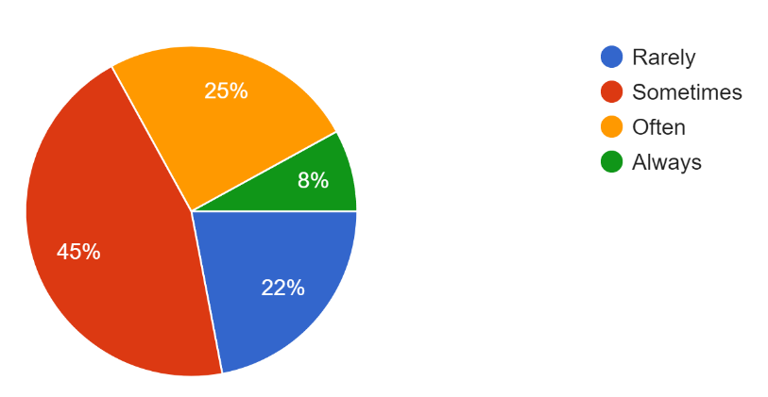

Time management habits Do SLIIT students plan their daily tasks often?

Slide 7
Do SLIIT students use time management tools or apps?

Slide 8

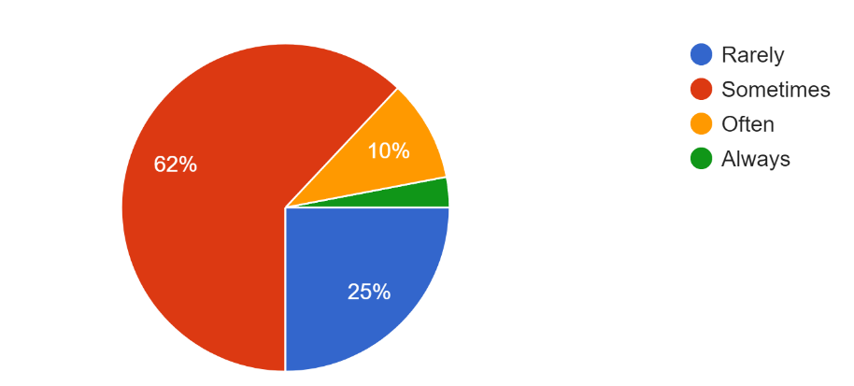



There are two types of shopping
Do SLIIT students use time management tools or apps?

Slide 9


Prioritizing Tasks and Managing Workload Challenges
Do SLIIT students find it challenging to balance their workload?

Slide 10
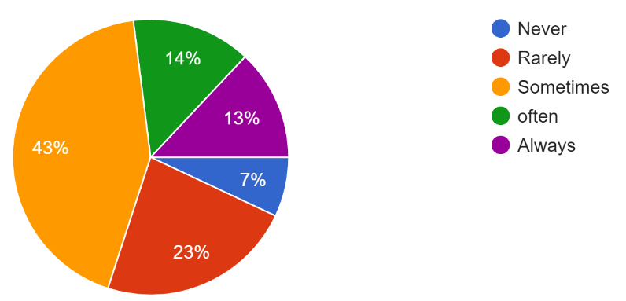

Prioritizing Tasks and Managing Workload Challenges
Do SLIIT students find it challenging to balance their workload?

Slide 11

Do SLIIT students prioritize tasks based on their importance?

Slide 12
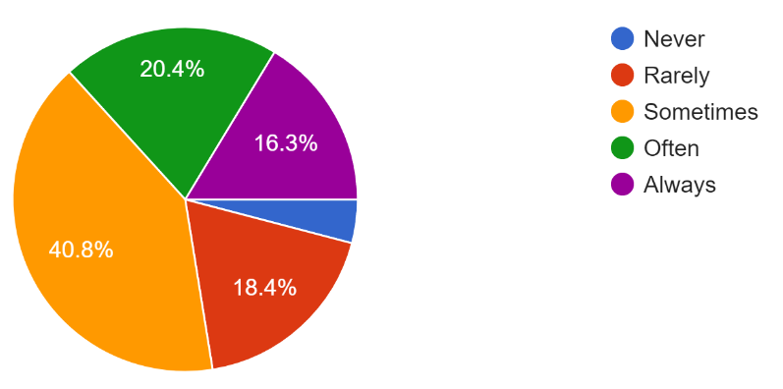

Do SLIIT students prioritize tasks based on their importance?

Slide 13


Seeking Guidance and Embracing Breaks for Effective Time Management
Do SLIIT students seek advice on time management?
This Photo by Unknown Author is licensed under CC BY

Slide 14
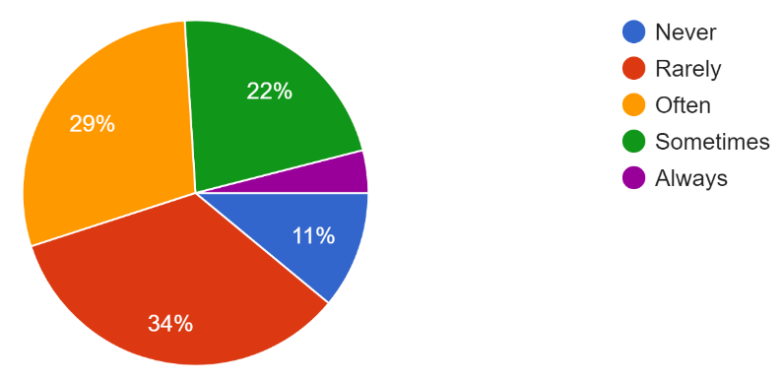

Seeking Guidance and Embracing Breaks for Effective Time Management
Do SLIIT students seek advice on time management?
This Photo by Unknown Author is licensed under CC BY

Slide 15

Do SLIIT students intentionally schedule breaks during their day?
This Photo by Unknown Author is licensed under CC BY

Slide 16
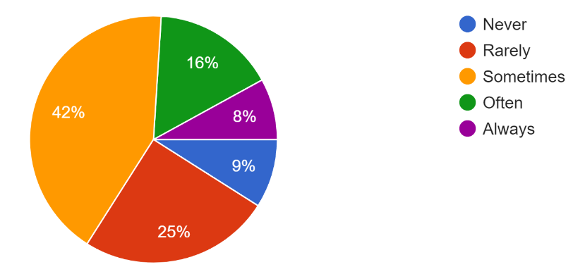

Do SLIIT students intentionally schedule breaks during their day?
This Photo by Unknown Author is licensed under CC BY

Slide 17


Assessing Time Management Skills and Academic Impact
On a scale of 1 to 5, how confident are SLIIT students in their time management skills?

Slide 18
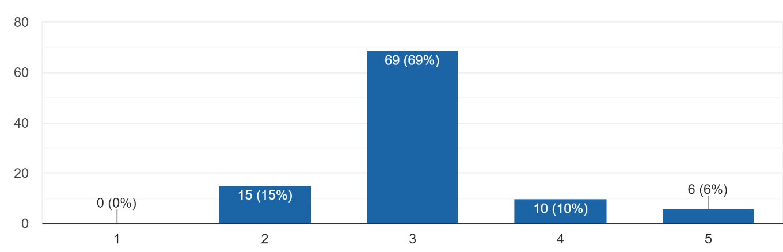
On a scale of 1 to 5, how confident are SLIIT students in their time management skills?

Slide 19

To what extent do SLIIT students believe time management impacts their academic performance?

Slide 20
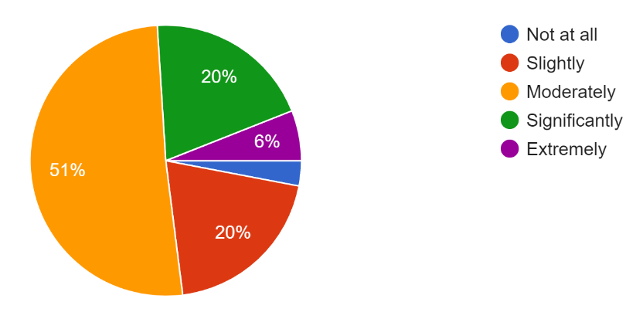
To what extent do SLIIT students believe time management impacts their academic performance?

Slide 21

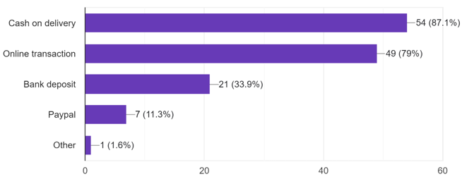
Payment methods used by SLIIT students
Advantages
Disadvantages

Slide 22
Advantages
Increased Productivity
Less Stress
Better Quality Work
Improved Work-Life Balance
Time for Self-Care
Achieving Goals
Greater Self-Discipline
Disadvantages

Slide 23
Advantages
Disadvantages

Slide 24

Disadvantages
Increased Stress ​
Poor Quality Work
Health Issues ​
Decreased Self-Confidence
Difficulty in Achieving Goals
Lower Productivity
Advantages

Slide 25

Disadvantages
Conclusion
Many SLIIT students attempt time management, yet occasionally falter due to their lack of experience or knowledge in the field.
The emphasis on effective time allocation underscores its importance in both academic success and personal well-being among SLIIT students.
Students should ask for help if they struggle with time management. Despite this, many rarely seek advice. Therefore, they shouldn't hesitate to ask for assistance to improve their time management skills.
Shipping problems and delays ​
Loss or damage of goods​
Frauds​
Returns can be complicated​
Spending too much time online​
Less contact with the community
Advantages

Slide 26


Our Group Members
IT23166110 – D.D. HAPUTHANTHRI
IT23156074 – R.M.H.I. RATHNAYAKE
IT23160866 – U.P.H.S ABEYWICKRAMA
IT23164376 – W.M.T.P.K WANASINGHE
IT23163218 – M.H.S. PERERA

Slide 27
Any Questions ?

